Slide 1
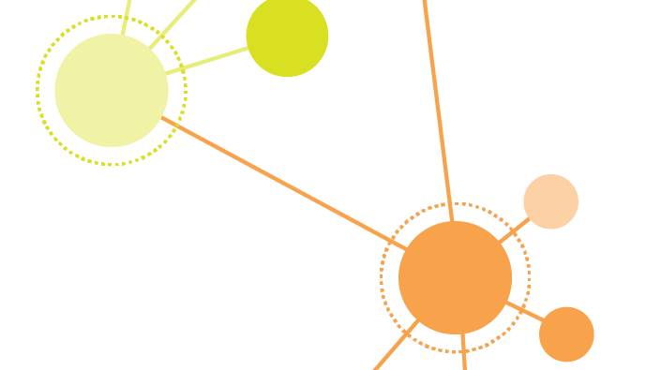
Group 2 : Network Analysis to Understand the Disease and Gene
CNT5805-20Fall 0058
Dec 2nd, 2020
Anwesh Praharaj
Shriram Sreedhar

Slide 2
Summary : -
Analyzed Disease-gene association network from the SNAP dataset
Disease are described as MESH (Medical subject heading) code and gene are described as UniProtIDs code
Included gene / disease vocabulary information from CTD database.
Found important nodes from Disease-Gene dataset to prepare below networks
Disease – Disease Network
Gene – Gene Network
Purpose : -
Our motivation for analyzing this dataset is to understand the relation between common disease associated with priority gene and common genes associated with priority diseases.
Here we are trying to segregate the network as per priority nodes but not as per functional area ( specific category of disease or gene )

Slide 3
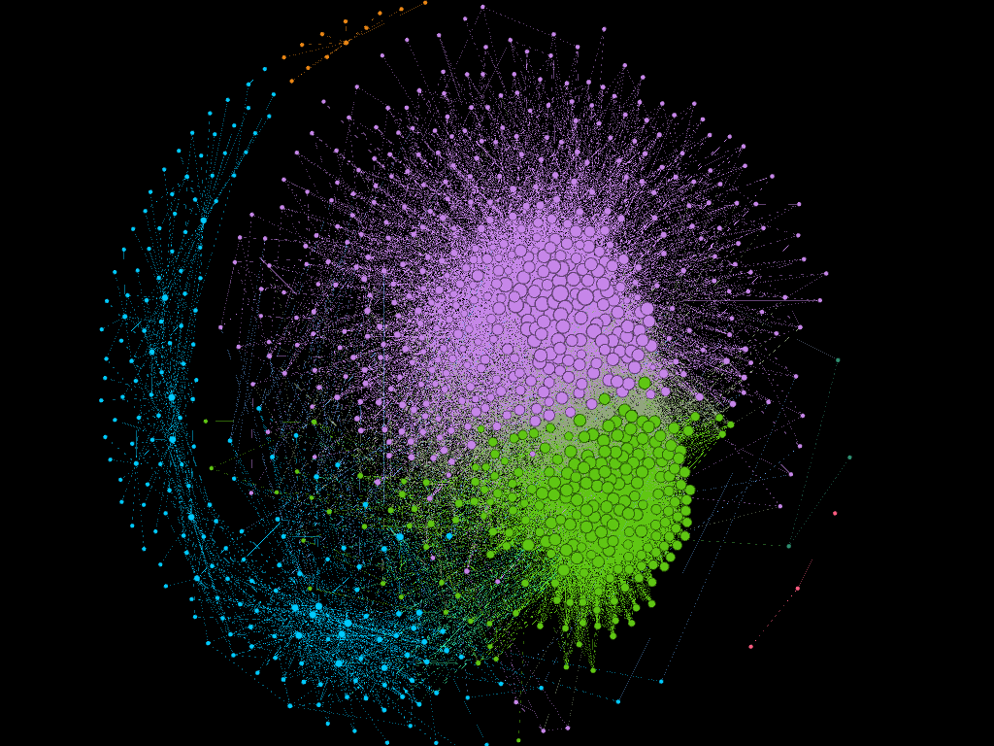

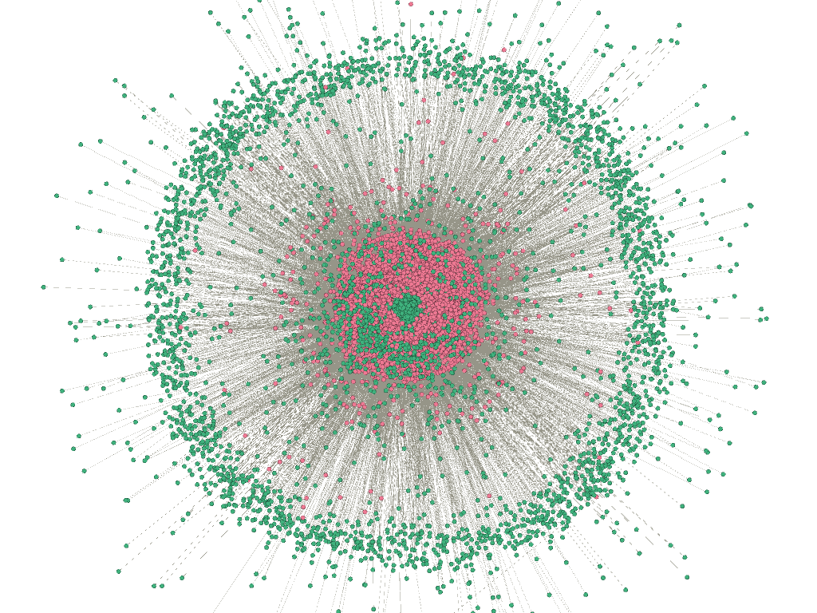
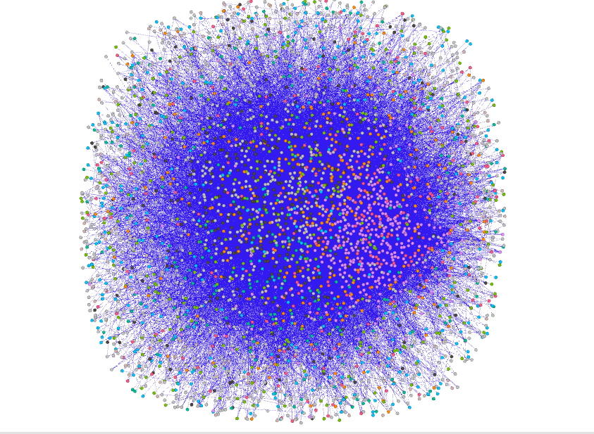
SNAP Dataset ( Disease – Gene Mapping)
CDT Database ( Disease & Gene Definition )
Data Wrangling , Cleansing & Prep ( Using Python - Panda Library )
Disease-Gene ( Nodes )
Disease-Gene ( Links )
Disease-Disease Network
Projection
Python & SQL
Disease-Gene Network
Gene-Gene Network

Slide 4
Research Question | Measurement | Network
1. What is the depth/degree of the relationship between participating nodes? | Degree Distribution | Disease-Gene
 |  | Disease-Disease
 |  | Gene-Gene
2. Are there identifiable clusters based on which the genes/Disease can be grouped? 3. How to find similarity between gene , Disease and its neighbor? | Leiden Algorithim & HITS | Disease-Gene
 | Clustering Co-efficient & Modularity | Disease-Disease
 |  | Gene-Gene
4. Are there identifiable hubs? | HITS ( Authorities & Hubs ) | Disease-Gene
 |  | Disease-Disease
 |  | Gene-Gene
5. What are the strongest nodes in terms of connectivity and what are the weakest nodes? 6. What is the betweenness of the nodes? | Centrality Measurement | Disease-Gene
 |  | Disease-Disease
 |  | Gene-Gene

Slide 5
Disease – Gene Bipartite Network
Gephi Network Visualization
Statistical Analysis
Filtering Network

Slide 6

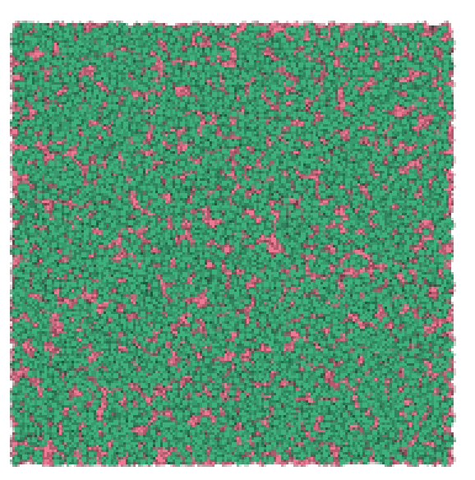
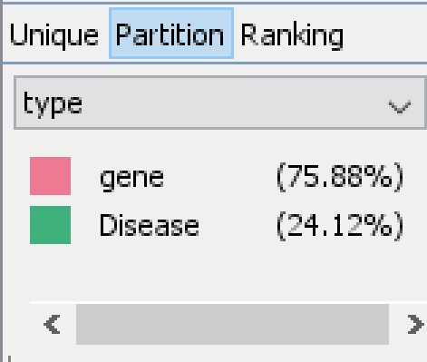
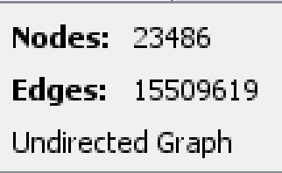
Network Overview
Nodes | Links | Graph Type |  | Weighted
23486 | 15509619 | Undirected | Bipartite | No
Initial Graph
Partition By Bipartite type

Slide 7
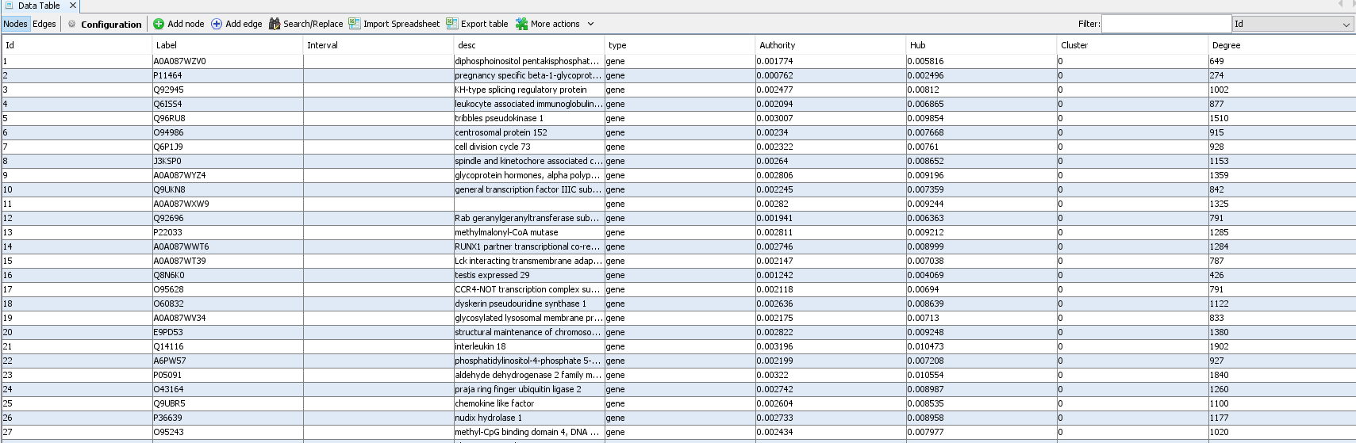
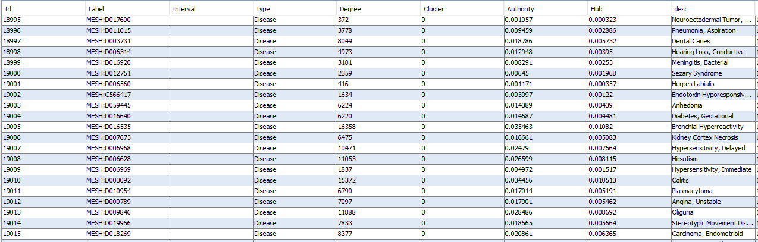
Nodes

Slide 8
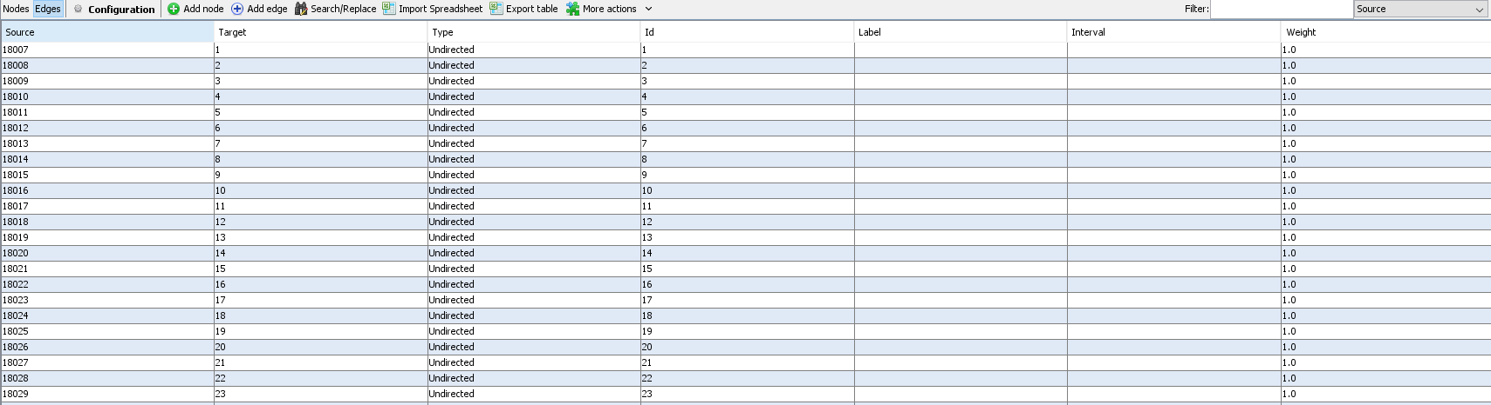
Edges

Slide 9
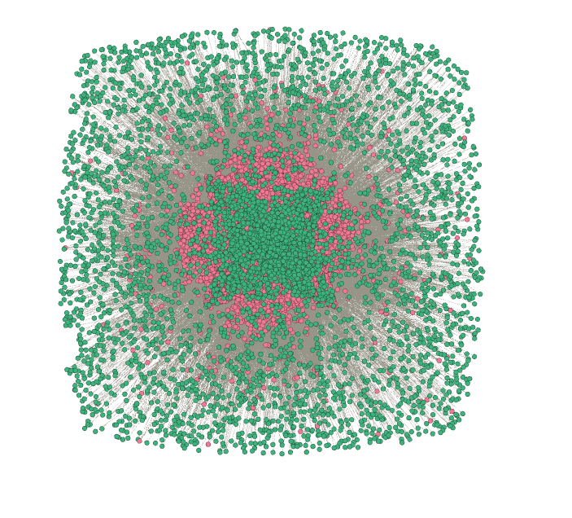
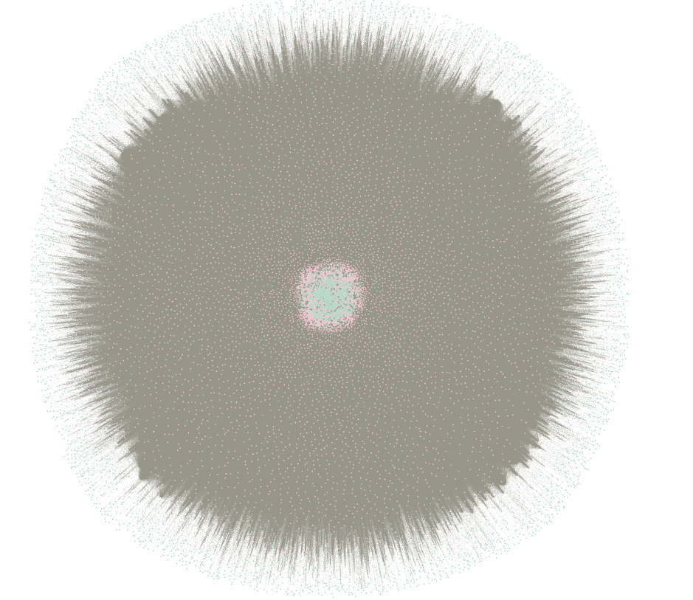
Different Layouts
Fruchterman Reingold
ForceAtlas 2
Yifan_Hu

Slide 10
Final Layout

Slide 11
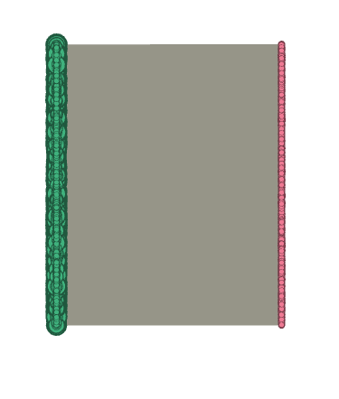
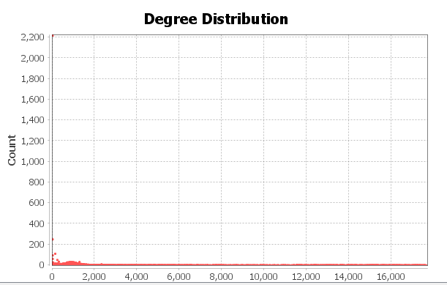
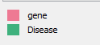
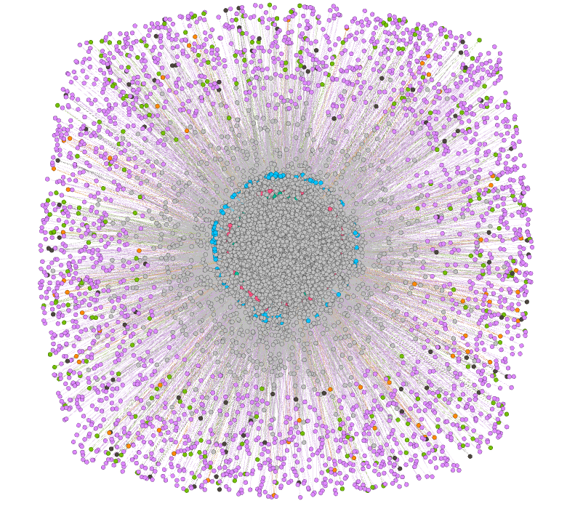
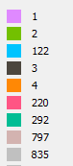
Statistical Analysis

Slide 12
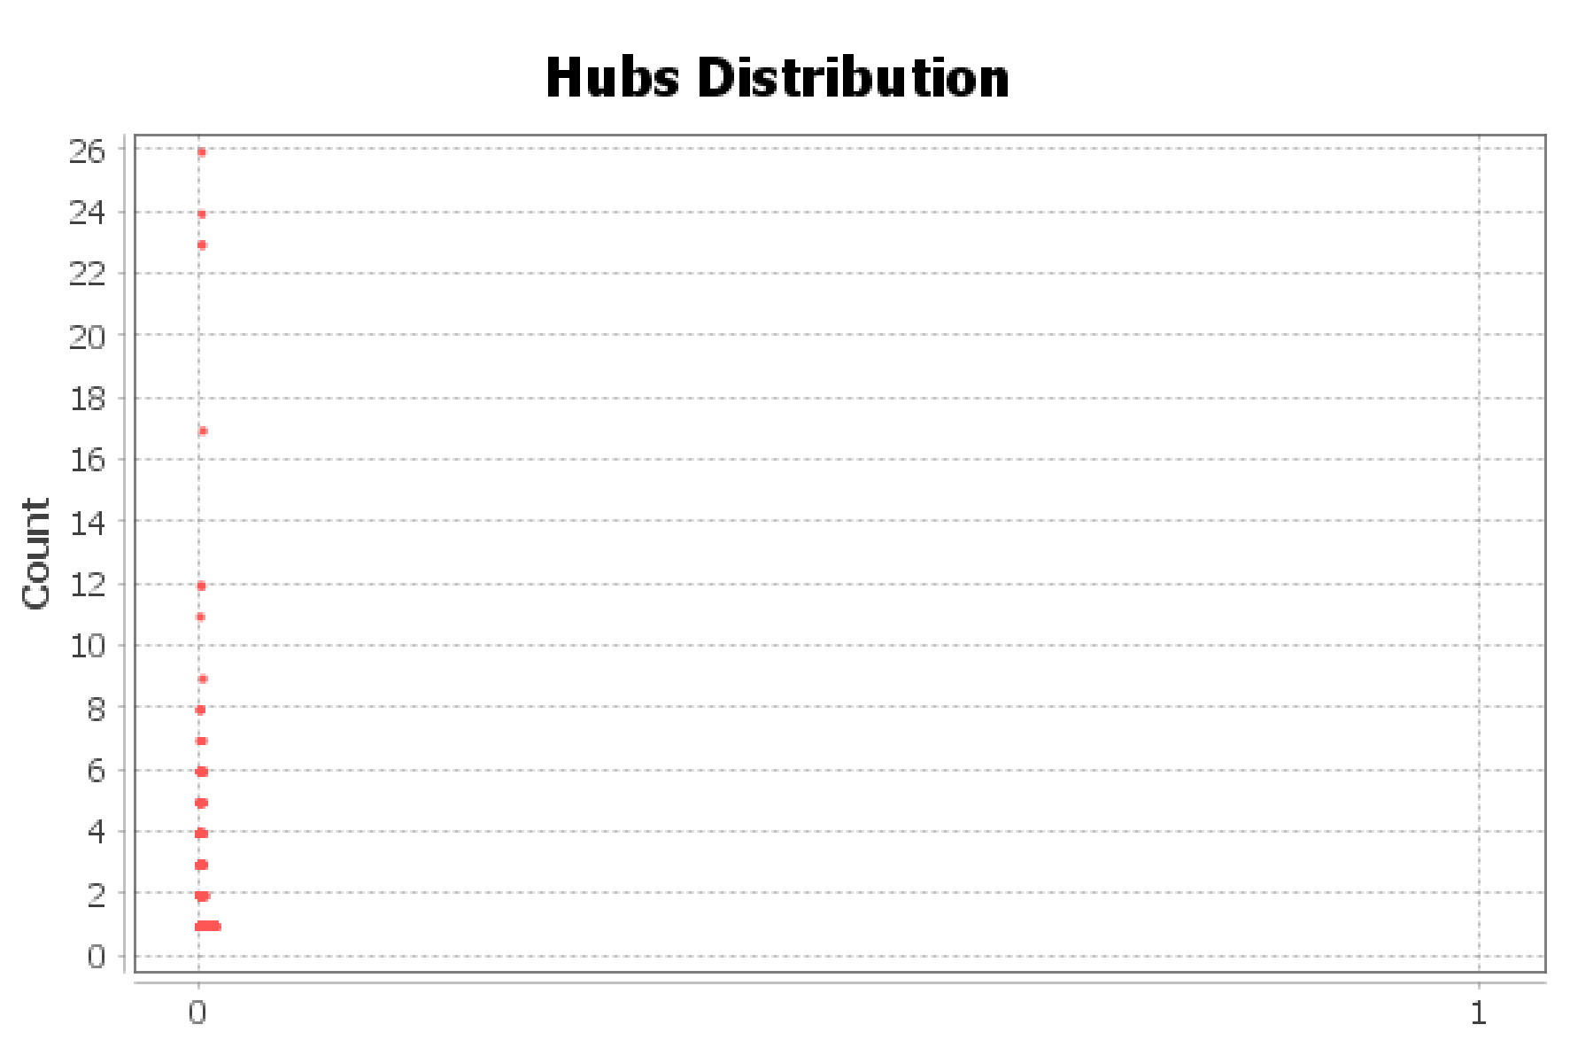
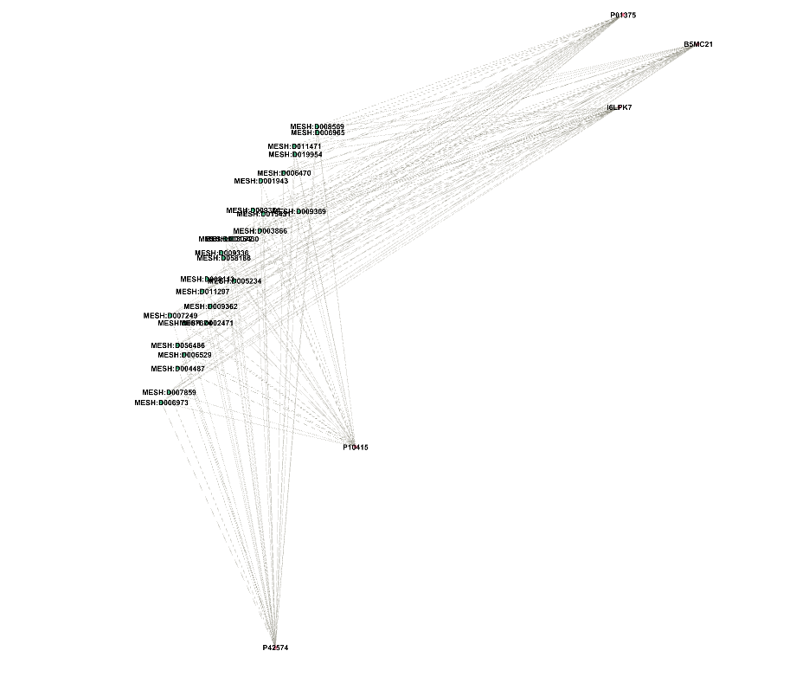
Disease | Hub Score
MESH:D009336 | 0.011289
MESH:D056486 | 0.011289
MESH:D007674 | 0.011282
MESH:D007249 | 0.011282
MESH:D011297 | 0.01128
MESH:D015431 | 0.011275
MESH:D007859 | 0.011273
MESH:D008569 | 0.011273
MESH:D005234 | 0.011272
MESH:D006973 | 0.011272
Gene | Hub Score
P01375 | 0.011274
P42574 | 0.011268
I6LPK7 | 0.011246
B5MC21 | 0.01124
P10415 | 0.011237
P01100 | 0.011216
A2A2V4 | 0.011201
P28482 | 0.011198
P04040 | 0.011196
P05412 | 0.011195

Slide 13
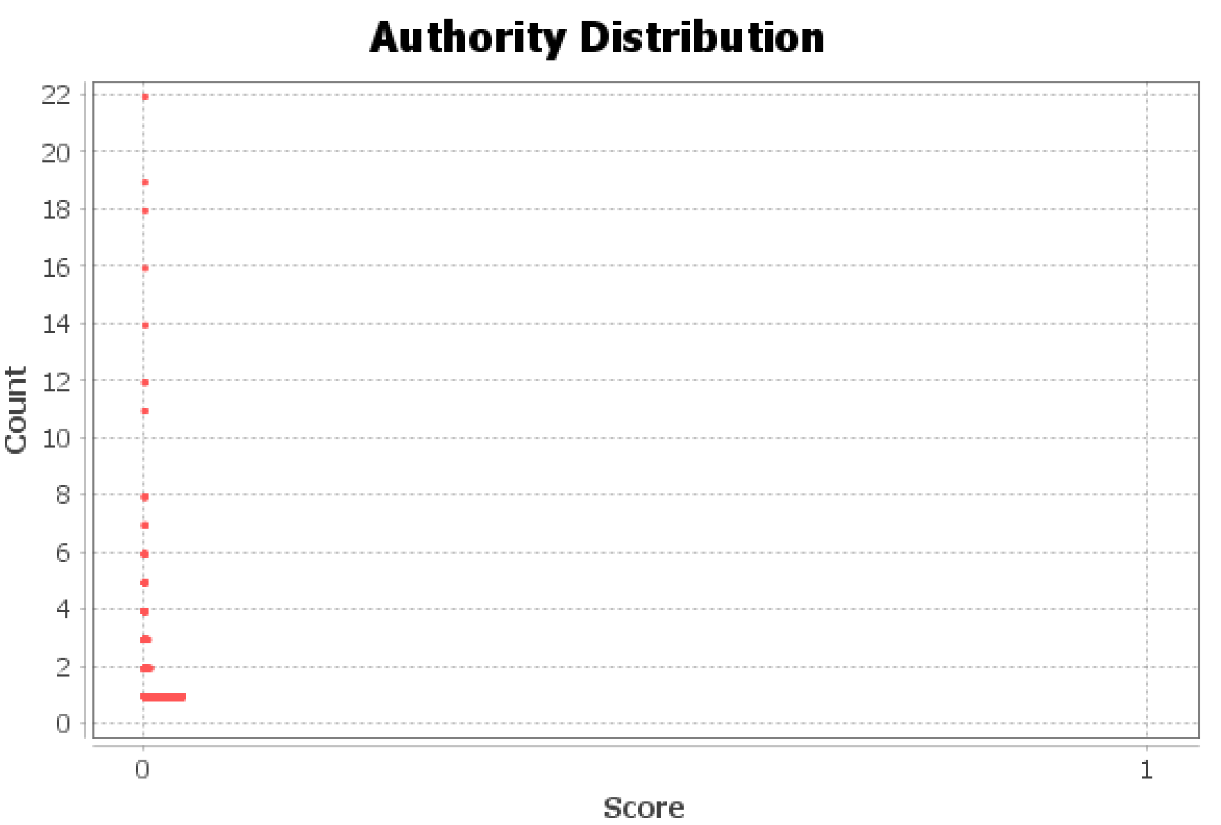
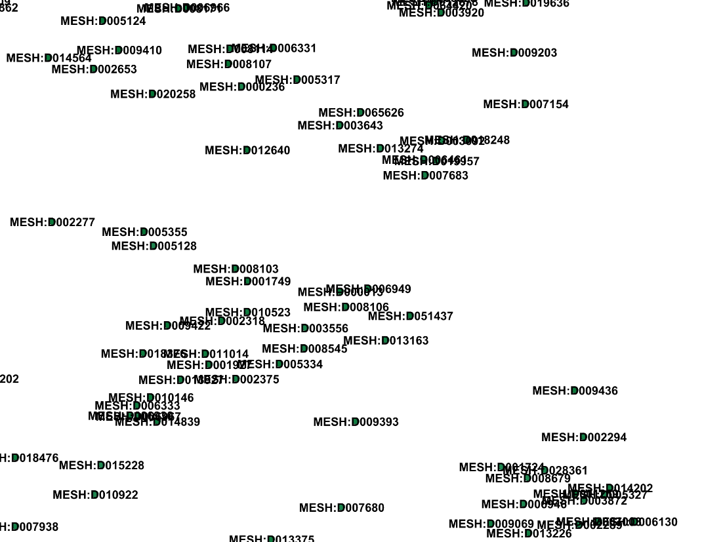
Disease | Authority
MESH:D009336 | 0.036999
MESH:D056486 | 0.036999
MESH:D007249 | 0.036977
MESH:D007674 | 0.036975
MESH:D011297 | 0.03697
MESH:D015431 | 0.036953
MESH:D008569 | 0.036947
MESH:D007859 | 0.036946
MESH:D005234 | 0.036944
MESH:D006973 | 0.036944
Gene | Authority
P01375 | 0.00344
P42574 | 0.003438
I6LPK7 | 0.003431
B5MC21 | 0.003429
P10415 | 0.003429
P01100 | 0.003422
A2A2V4 | 0.003418
P28482 | 0.003416
P04040 | 0.003416
P05412 | 0.003416

Slide 14
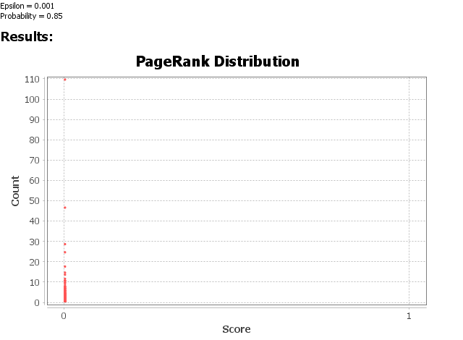
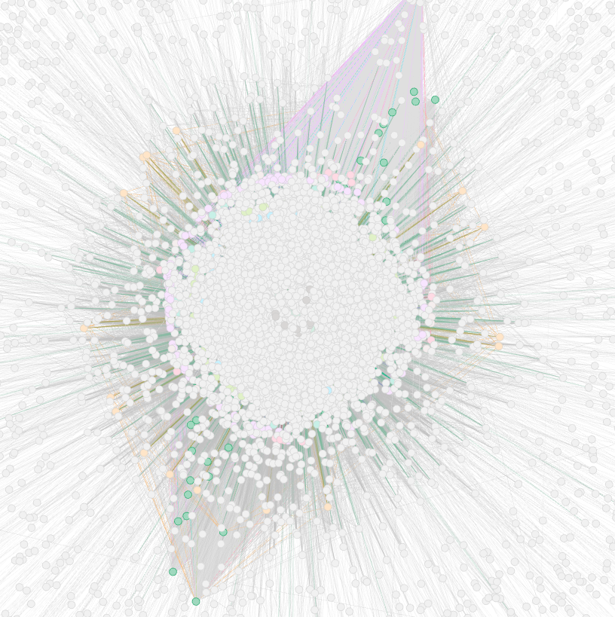
Disease | PageRank
MESH:D007249 | 0.000575
MESH:D009336 | 0.000566
MESH:D056486 | 0.000565
MESH:D008569 | 0.000556
MESH:D001943 | 0.000553
MESH:D011297 | 0.000553
MESH:D002471 | 0.000551
MESH:D007859 | 0.00055
MESH:D006965 | 0.00055
MESH:D007674 | 0.000549
Gene | PageRank
P01375 | 0.00013
P02458 | 0.000116
P01584 | 0.000115
P42574 | 0.000112
B5MC21 | 0.000109
A0A087WT22 | 0.000103
P04040 | 0.000101
P08684 | 0.000101
P01579 | 0.000099
P10145 | 0.000098

Slide 15
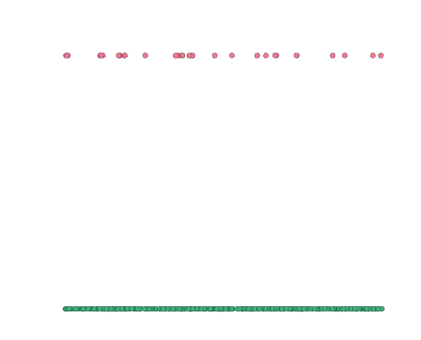
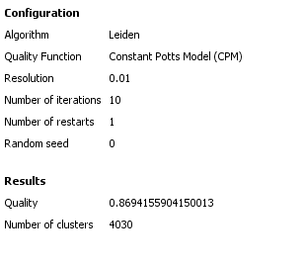
Leiden Algorithm
Disease | Cluster
MESH:D005401 | 4013
MESH:D029503 | 4010
MESH:D007645 | 3998
MESH:C536990 | 3996
MESH:C537240 | 3995
MESH:C537081 | 3994
MESH:C567489 | 3993
MESH:C535396 | 3992
MESH:C567383 | 3991
MESH:D049068 | 3990
Gene | Cluster
A6NJZ3 | 4029
H3BQB6 | 4028
Q8NGF6 | 4027
Q5T870 | 4026
Q9H343 | 4025
Q8N349 | 4024
Q6UWN8 | 4023
G3V1C2 | 4022
Q96RI8 | 4021
Q9GZY0 | 4020

Slide 16
Filtering Criteria
Top 20 Gene
Top 20 Disease
Gene | PageRank | Degree | Authority Score
P01375 | 0.00013 | 2801 | 0.00344
P01584 | 0.000115 | 2616 | 0.00339
P42574 | 0.000112 | 2754 | 0.003438
B5MC21 | 0.000109 | 2690 | 0.003429
A0A087WT22 | 0.000103 | 2475 | 0.003397
P04040 | 0.000101 | 2582 | 0.003416
P08684 | 0.000101 | 2444 | 0.003411
P01579 | 0.000099 | 2516 | 0.003411
P10145 | 0.000098 | 2496 | 0.003393
P02768 | 0.000096 | 2480 | 0.003393
P10415 | 0.000095 | 2593 | 0.003429
I6LPK7 | 0.000094 | 2599 | 0.003431
A0A0C4DFU1 | 0.000094 | 2401 | 0.003401
P08183 | 0.000092 | 2424 | 0.003399
P14780 | 0.000092 | 2410 | 0.003416
P28482 | 0.000091 | 2549 | 0.003416
P27361 | 0.00009 | 2532 | 0.003411
A2A2V4 | 0.000088 | 2475 | 0.003418
P13500 | 0.000088 | 2500 | 0.003411
Label | Degree | Authority | pageranks
MESH:D007249 | 17693 | 0.036977 | 0.000575
MESH:D009336 | 17683 | 0.036999 | 0.000566
MESH:D056486 | 17679 | 0.036999 | 0.000565
MESH:D008569 | 17550 | 0.036947 | 0.000556
MESH:D011297 | 17580 | 0.03697 | 0.000553
MESH:D001943 | 17550 | 0.036932 | 0.000553
MESH:D002471 | 17497 | 0.036868 | 0.000551
MESH:D007859 | 17536 | 0.036946 | 0.00055
MESH:D006965 | 17508 | 0.036902 | 0.00055
MESH:D007674 | 17576 | 0.036975 | 0.000549
MESH:D003072 | 17486 | 0.036919 | 0.000548
MESH:D015431 | 17527 | 0.036953 | 0.000547
MESH:D048629 | 17325 | 0.036719 | 0.000547
MESH:D011471 | 17411 | 0.03682 | 0.000545
MESH:D009369 | 17333 | 0.036818 | 0.000544
MESH:D008175 | 17237 | 0.036677 | 0.000544
MESH:D009374 | 17443 | 0.036861 | 0.000543
MESH:D005234 | 17494 | 0.036944 | 0.000542
MESH:D008113 | 17398 | 0.036822 | 0.000542
Find top 20 Gene & Disease by Page Rank , Degree and Authority score.
Disease-Disease Network → Find all the Diseases associated with top 20 Gene.
Gene-Gene Network → Find all the genes associated with top 20 Disease.

Slide 17
Disease – Disease Network
Gephi Network Visualization
Statistical Analysis
Filtering Network

Slide 18

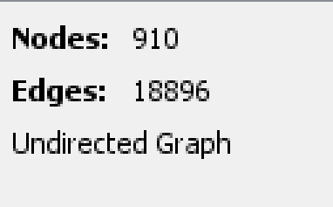
Network Overview
Nodes | Links | Graph Type | Weighted
910 | 18896 | Undirected | No
Initial Graph

Slide 19
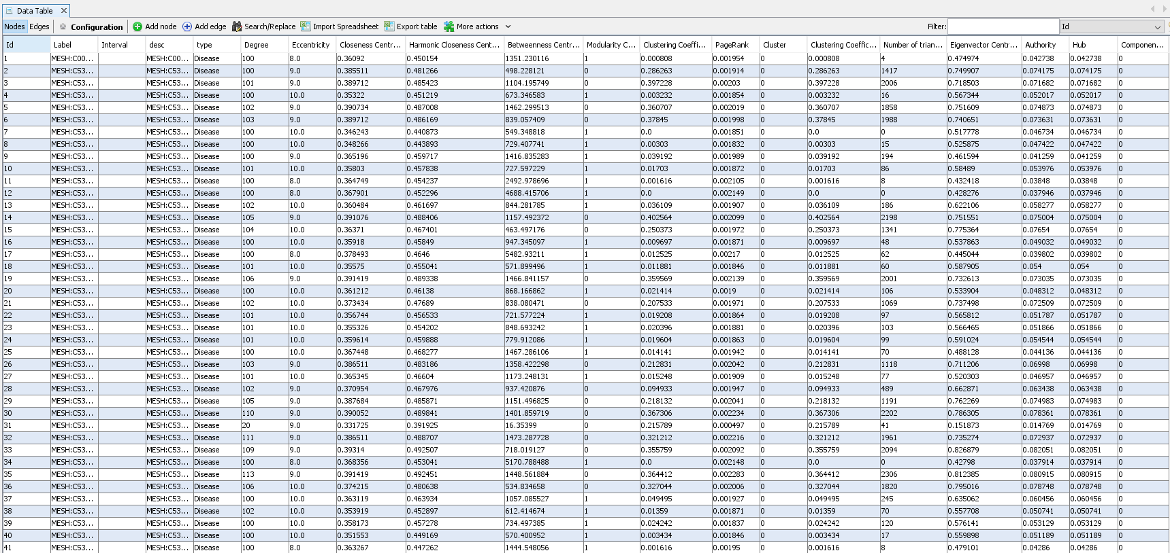
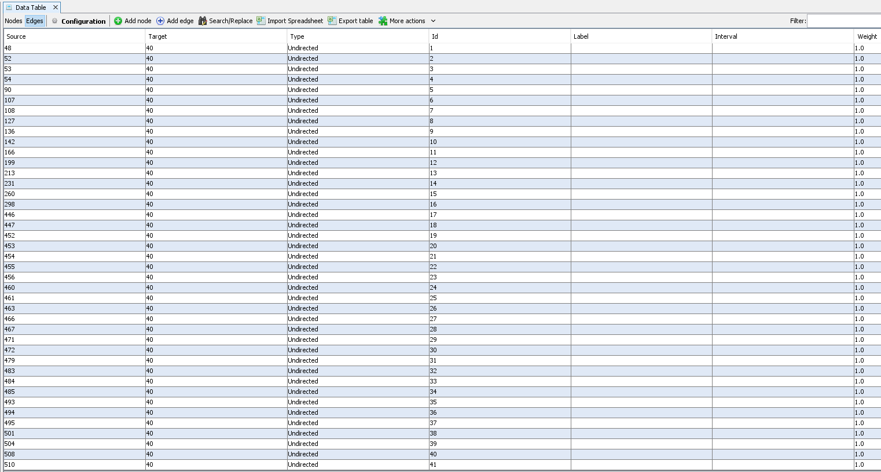

Slide 20
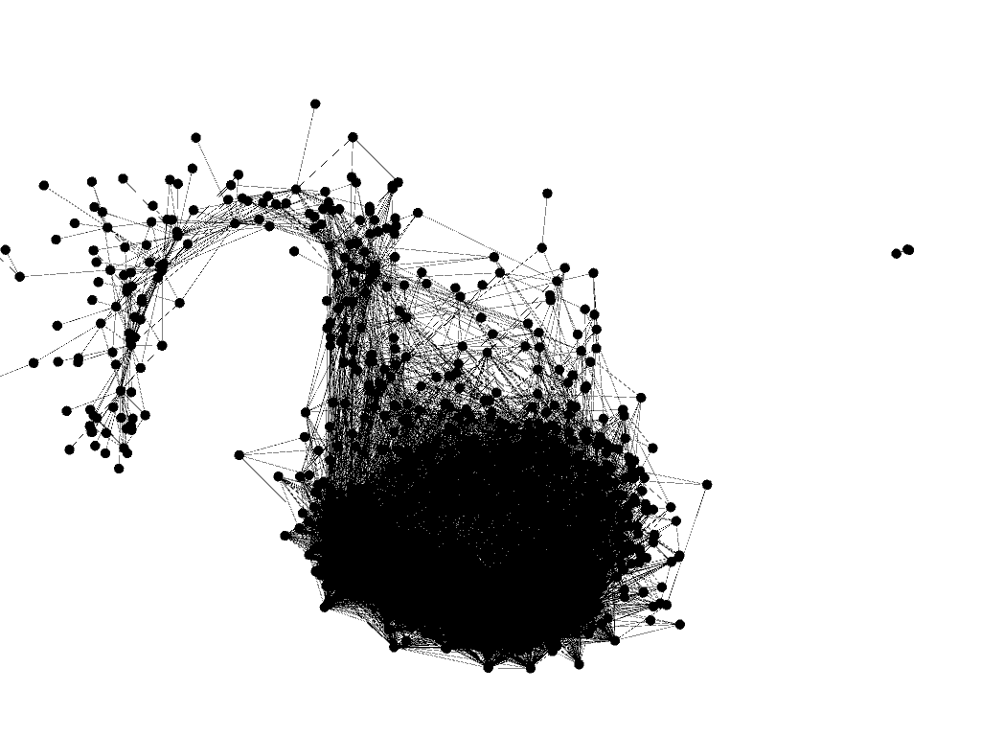
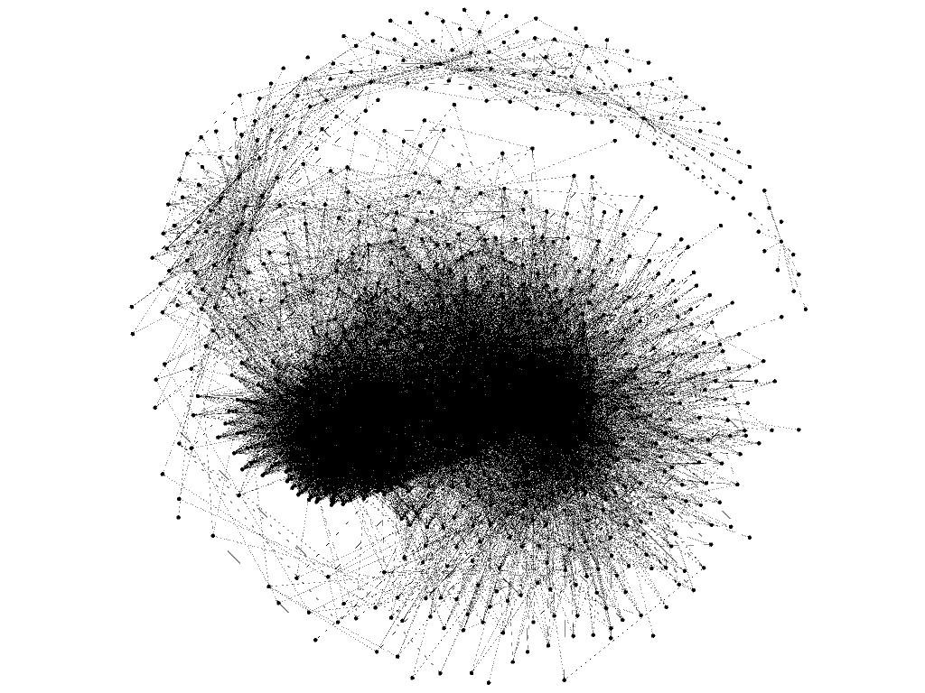
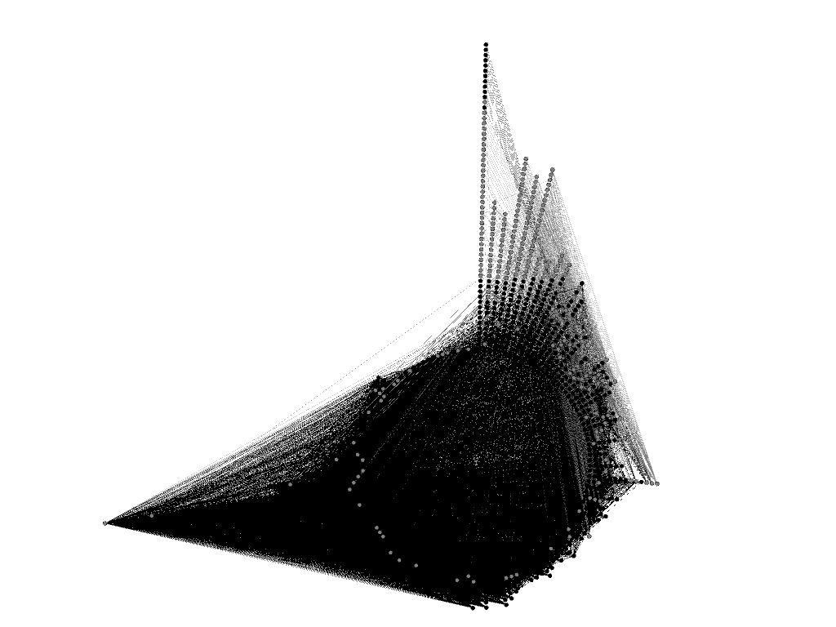
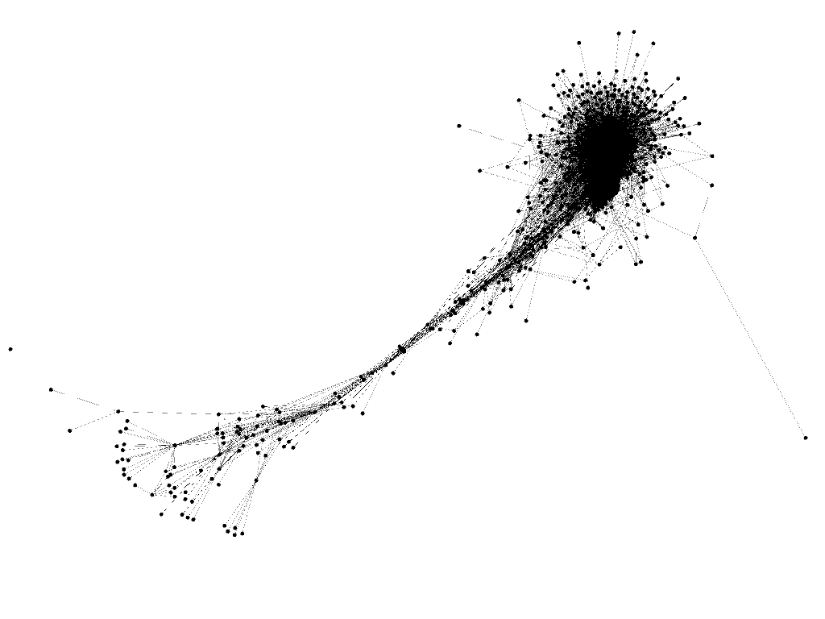
Different Layouts
OpenOrd
Fruchterman Reingold
Radial Axis
Yifan Hu

Slide 21
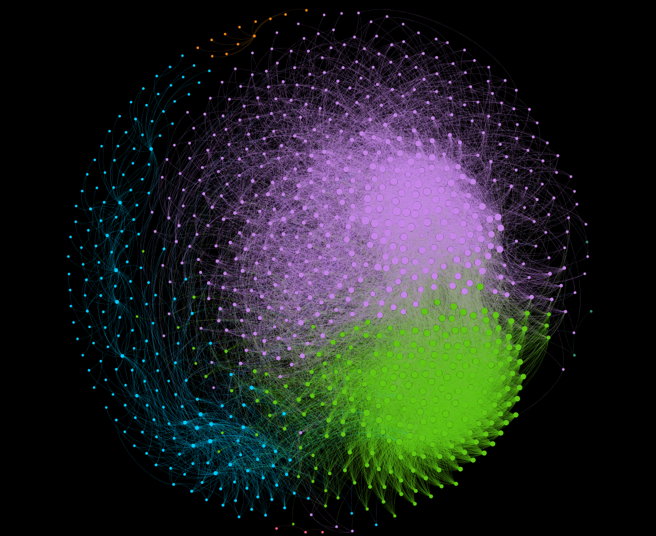
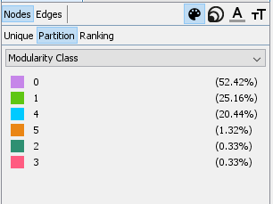
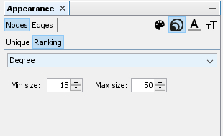
Final Layout

Slide 22
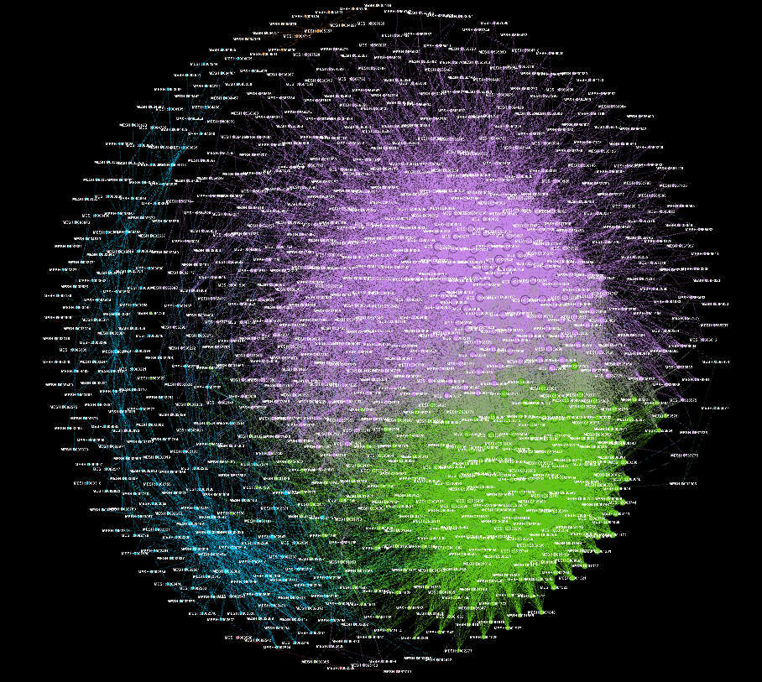
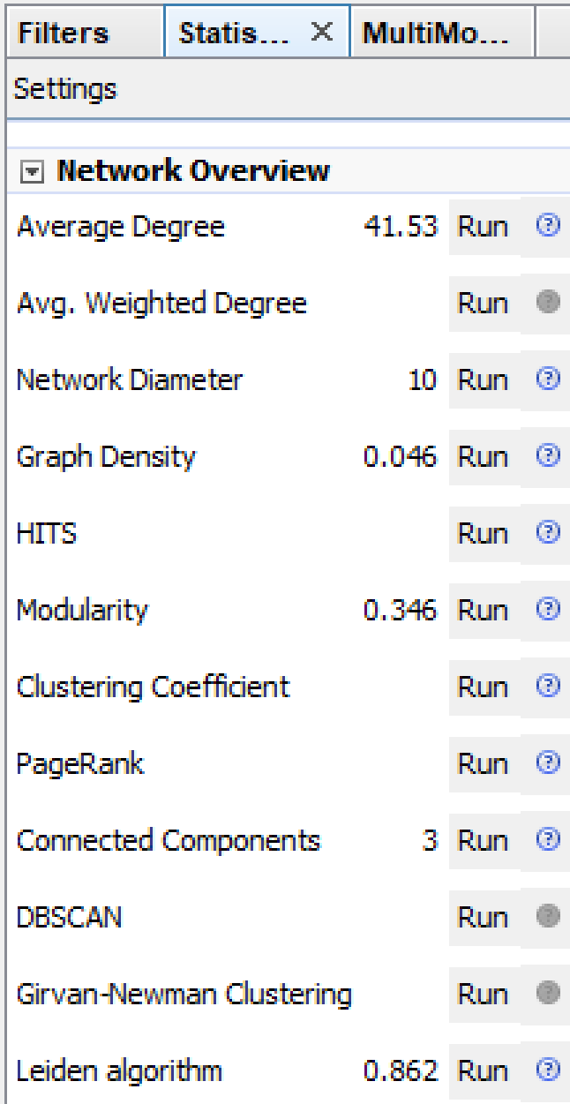

Slide 23
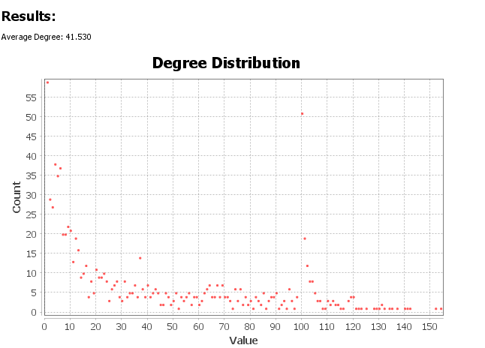
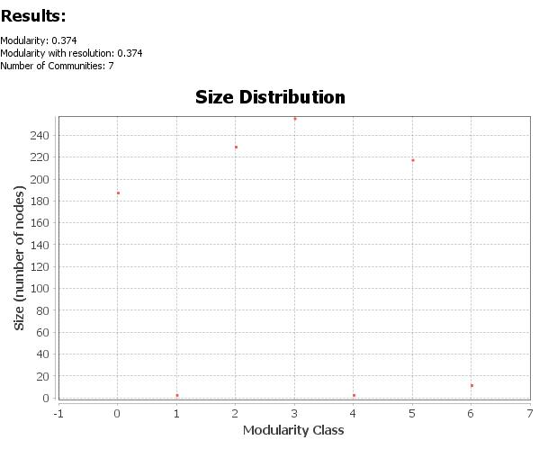
Statistical Analysis
X Axis: Degree Value
Y Axis: Number of Nodes
It is a scale free network as the graph follow nearly power law.
Network diameter is 10, which means it would take 10 steps to traverse the graph between its two most distant nodes
Modularity measurement divide the network in communities. Here we have
7 modules.

Slide 24
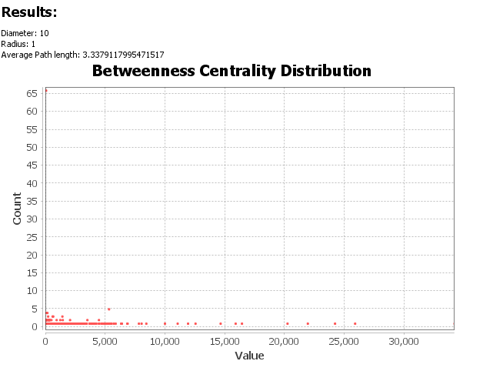
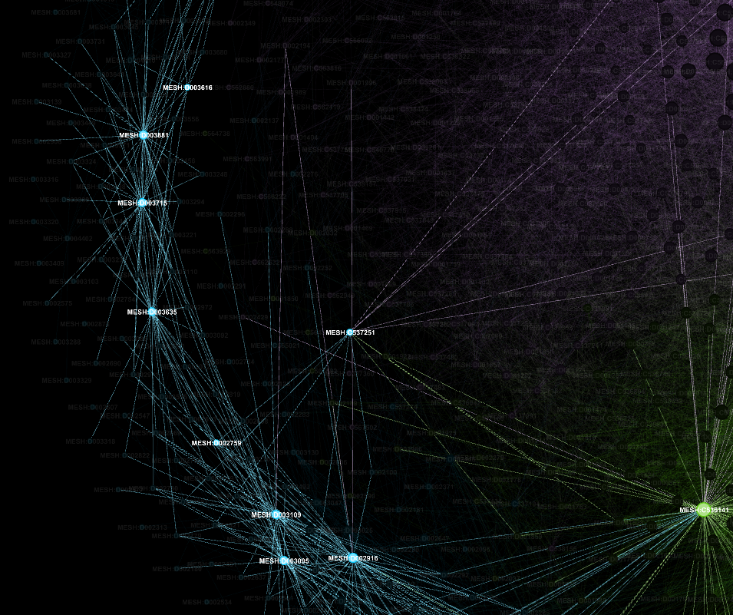
Disease | Centrality Score
MESH:D003635 | 34170.789
MESH:C537251 | 25850.80882
MESH:D002759 | 24171.68661
MESH:D003109 | 21892.13352
MESH:D003715 | 20195.71759
MESH:D003881 | 16385.57582
MESH:D003095 | 15858.54343
MESH:D002916 | 14601.38808
MESH:D003616 | 12497.57049
MESH:C536141 | 11874.85334

Slide 25
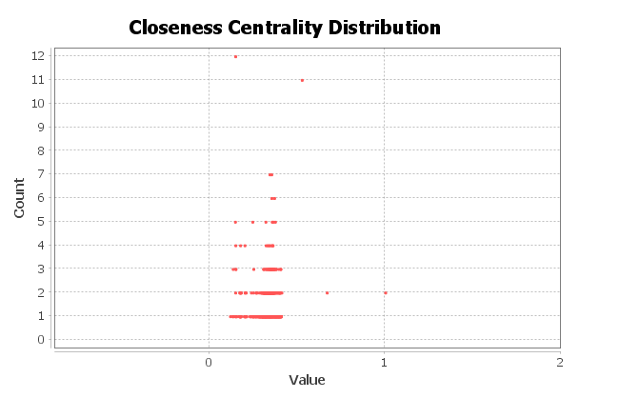
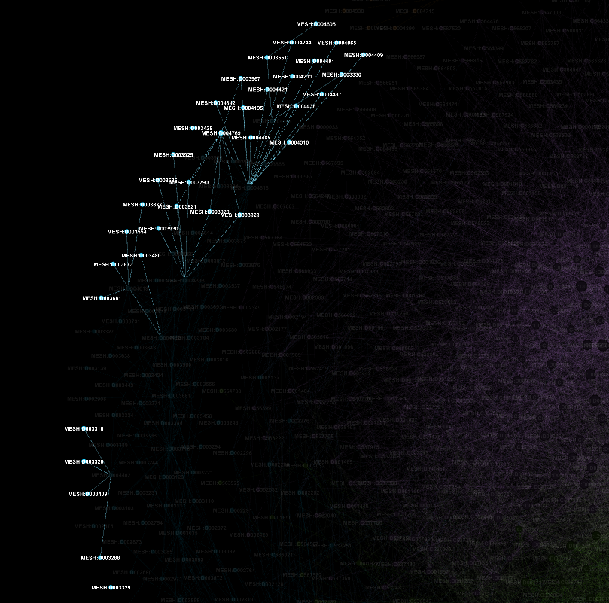
Disease | Centrality Score
MESH:D004605 | 0.114763
MESH:D004769 | 0.127587
MESH:D003330 | 0.129584
MESH:D003551 | 0.129622
MESH:D003554 | 0.130378
MESH:D003677 | 0.130378
MESH:D003681 | 0.130378
MESH:D003428 | 0.142675
MESH:D003288 | 0.142949
MESH:D003316 | 0.142949

Slide 26
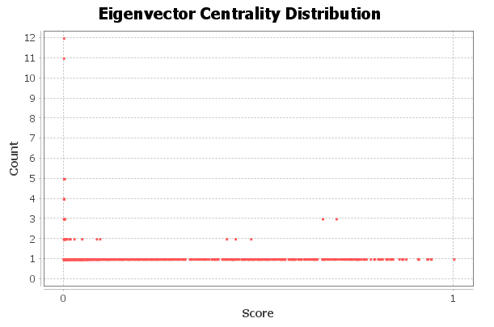
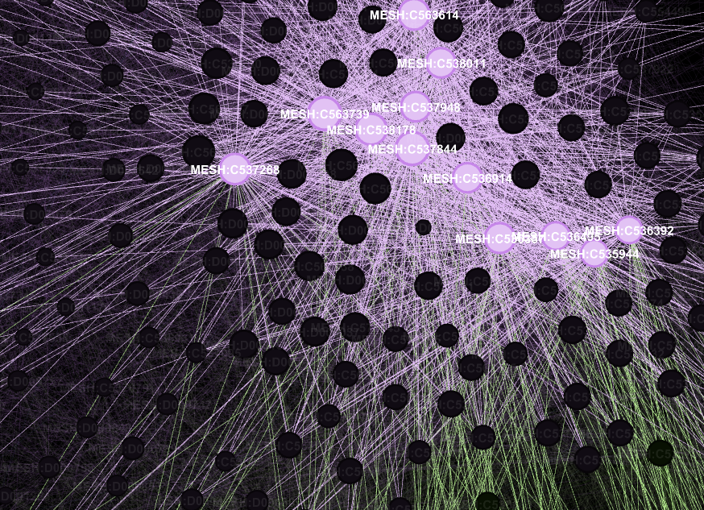
Disease | Centrality Score
MESH:C538178 | 1
MESH:C537844 | 0.941728
MESH:C536357 | 0.941043
MESH:C537948 | 0.933664
MESH:C536914 | 0.931269
MESH:C538011 | 0.90959
MESH:C536495 | 0.908401
MESH:C563739 | 0.9075
MESH:C563614 | 0.877281
MESH:C536392 | 0.869671

Slide 27
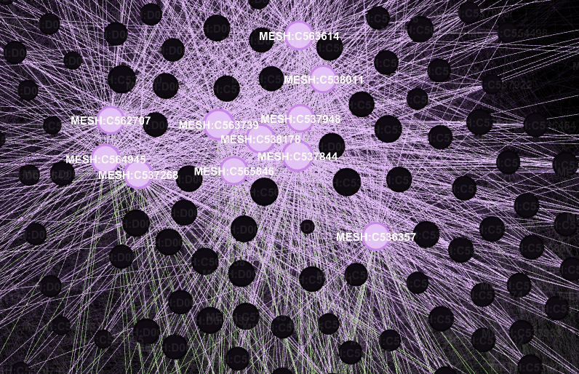
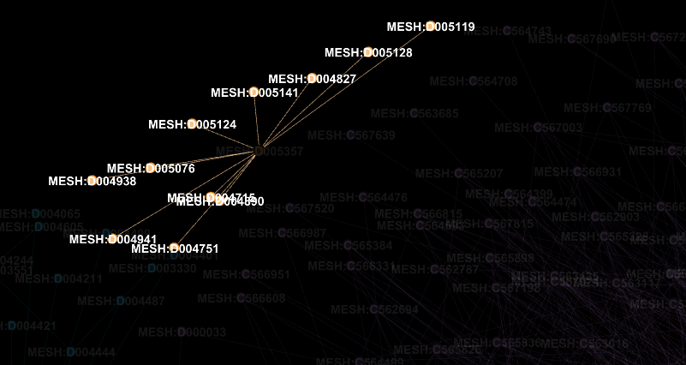
Degree of distribution
Highest Degree
Disease | Degrees
MESH:C537844 | 154
MESH:C563739 | 152
MESH:C538178 | 142
MESH:C564945 | 141
MESH:C563614 | 140
MESH:C537268 | 137
MESH:C565846 | 135
MESH:C536357 | 134
MESH:C562707 | 132
MESH:C537948 | 131
Lowest Degree

Slide 28
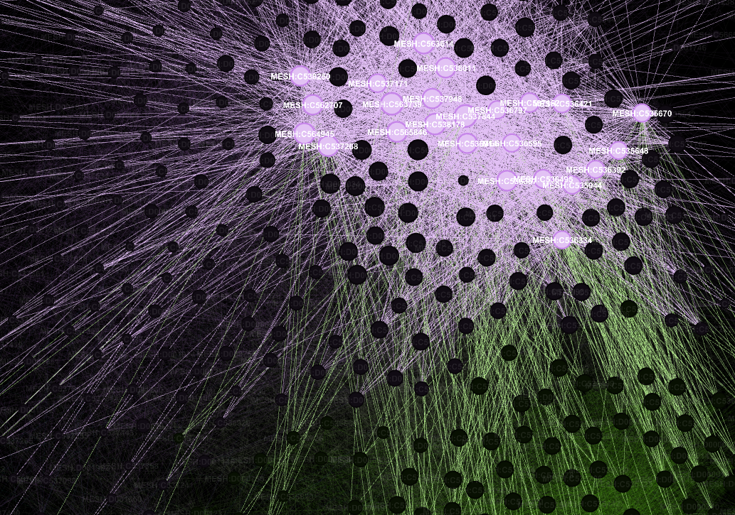
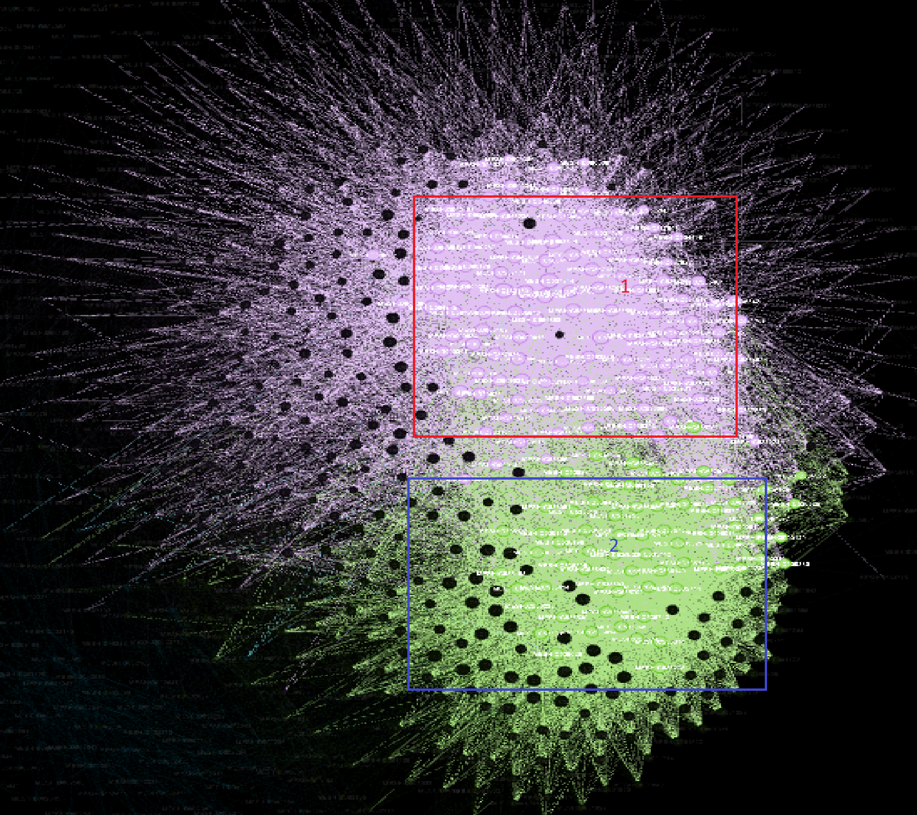
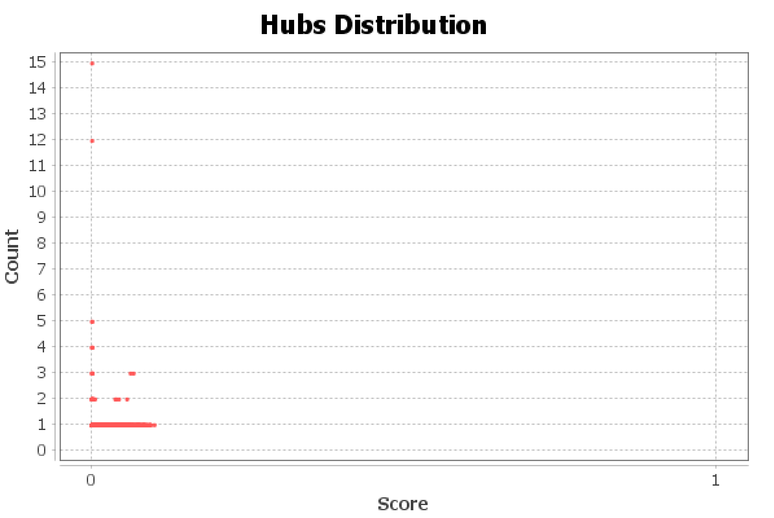
Hub in the network
Disease | Hub Score
MESH:C536357 | 0.093241
MESH:C536495 | 0.089846
MESH:C536914 | 0.092866
MESH:C537844 | 0.093231
MESH:C537948 | 0.093109
MESH:C538011 | 0.090719
MESH:C538178 | 0.0997
MESH:C563614 | 0.08725
MESH:C563739 | 0.089798

Slide 29





Clustering in Network
Disease | Clustering Co-efficient
MESH:C564133 | 1
MESH:C564567 | 1
MESH:C565193 | 1
MESH:C565780 | 1
MESH:C567582 | 1
MESH:C567502 | 1

Slide 30






Modularity
6
3
4
1-2
0
5

Slide 31


Density of the network is very less 0.046.
Average Clustering co-efficient is 0.149

Slide 32
Gene – Gene Network
Gephi Network Visualization
Statistical Analysis
Filtering Network

Slide 33


Network Overview
Nodes | Links | Graph Type | Weighted
3594 | 35700 | Undirected | No

Slide 34



Different Layouts
Yifan-Hu
Force Atlas 2
Frutcherman-Reginold

Slide 35

Final Layout

Slide 36

Nodes

Slide 37

Edges

Slide 38

Statistical Analysis

Slide 39




Centrality Measurement

Slide 40


Slide 41


Slide 42



Slide 43

Modularity Report
Results:
Randomize: On
Resoultion:1.0
Modularity:0.517
Modularity with resolution:0.517
Number of communities:57

Slide 44


Modularity

Slide 45

Graph Density

Slide 46


Conclusion
Used python and SQL to prepare and transform SNAP data into meaningful dataset.
Transformed Disease-gene bipartite network into two monopartite network Disease-Disease and gene-gene
Analyzed Important/ relevant nodes in all the network by utilizing different statistical analysis.
Learned the characteristics of bipartite network.
Future Work
Can use different machine learning algorithms to find the priority gene and disease in network.
Can use weighted network to find which disease or genes are more likely to relate each other.
Can decompose the network to analyze specific area of genetic diseases.

